Slide 1

WEEK 6
19th SEPTEMBER–
22nd SEPTEMBER
RUT CHOLERA
EMP CODE: 655095

Slide 2
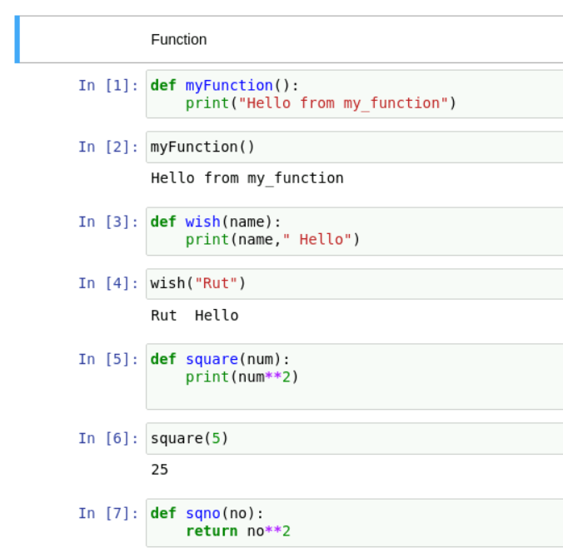
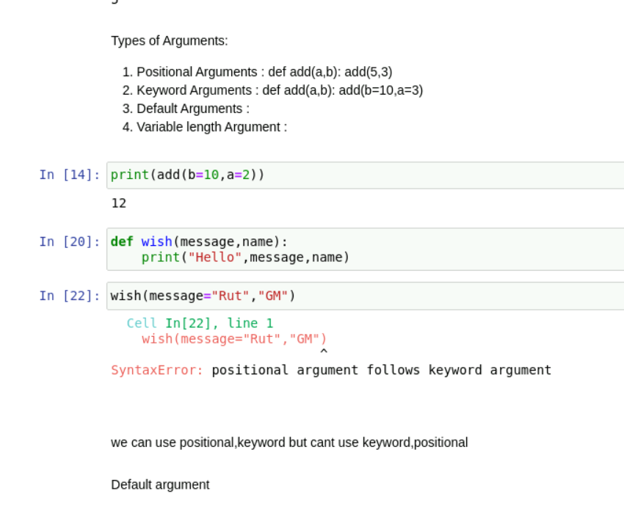
19th september
Functions in python, list expressions, types of arguments

Slide 3
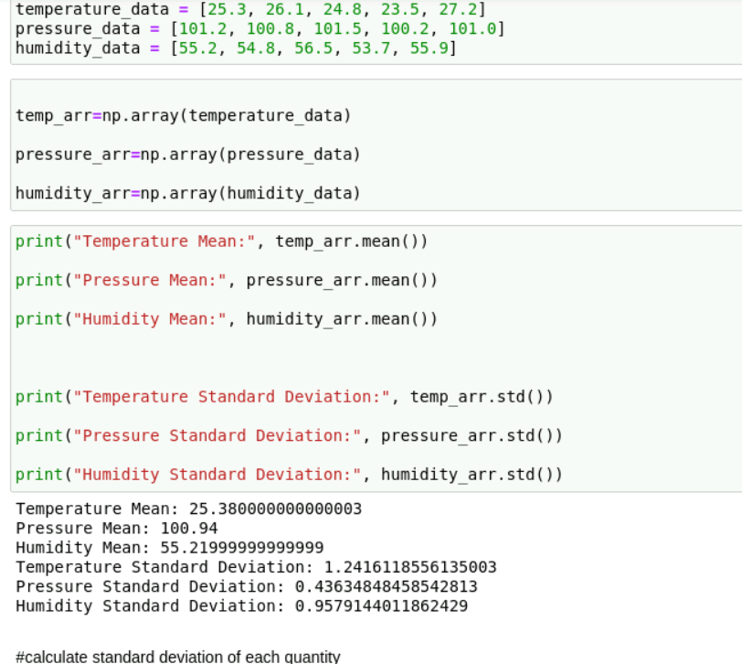
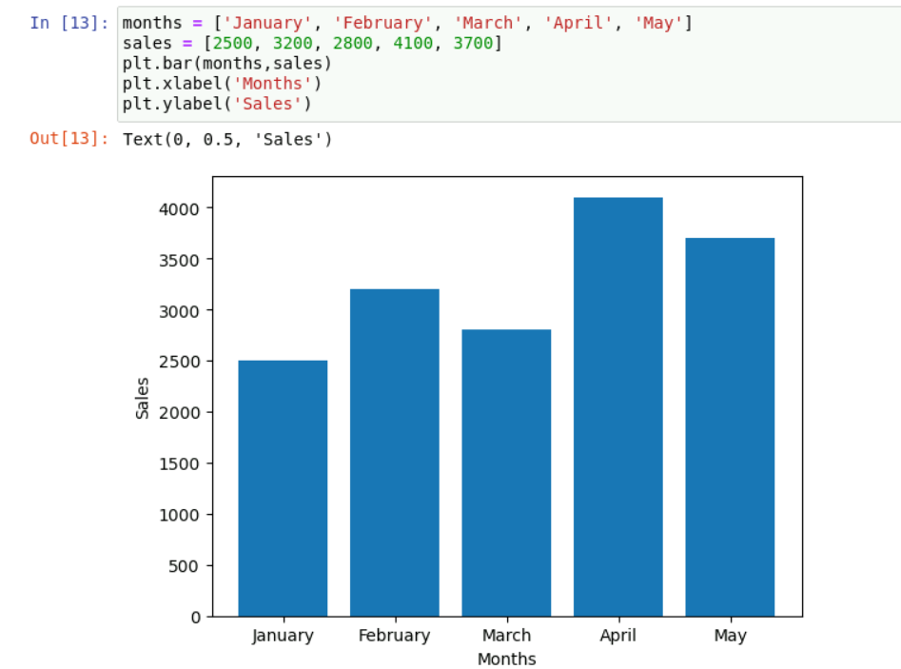
20TH SEPTEMBER- MATPLOTLIB AND PANDAS

Slide 4
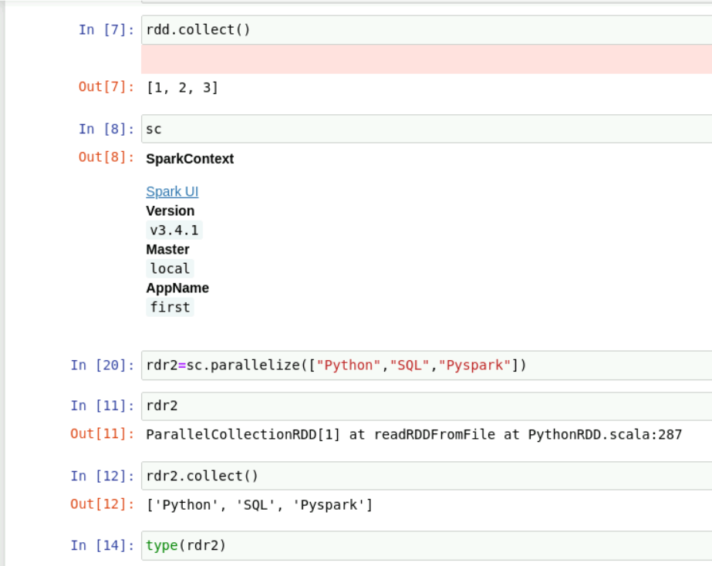
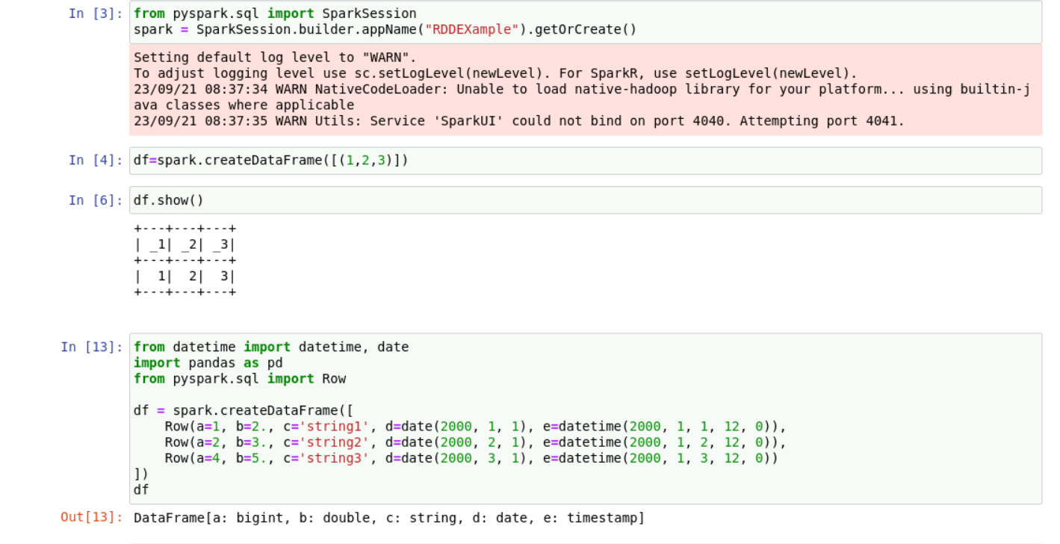
21ST SEptember
Pyspark basics and sessions

Slide 5
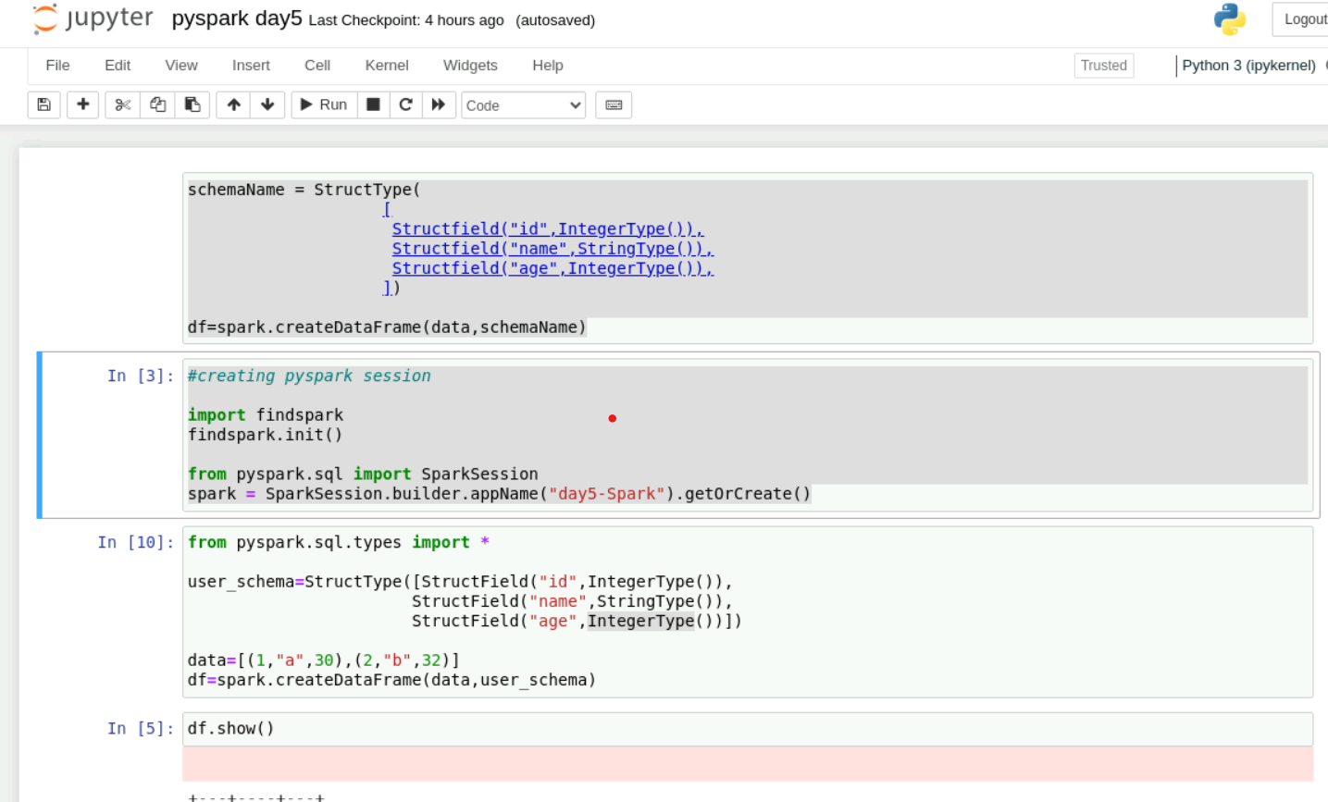
22nd september
Pyspark handson

Slide 6
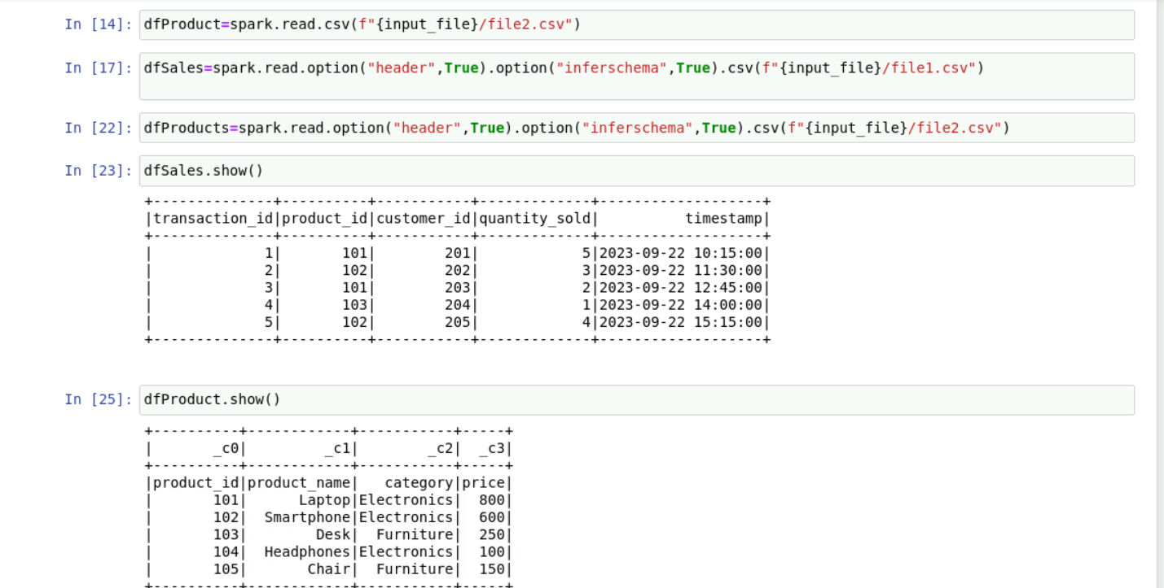
22ND SEPTEMBER PYSPARK HANDSON

Slide 7
THANK YOU

